Slide 1
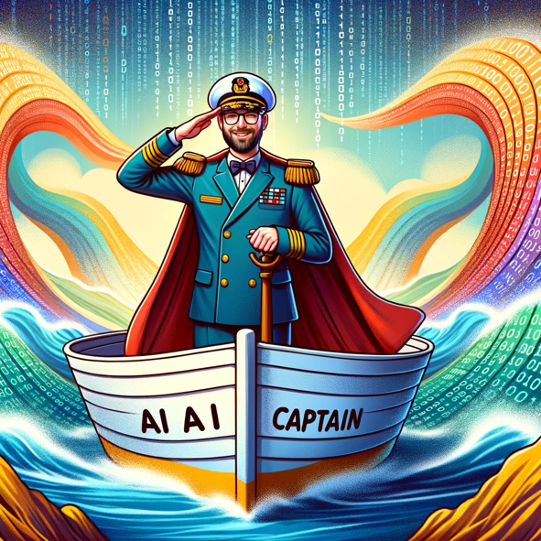
(Gen)AI
At VodafoneZiggo
Notes:
AI:
Introduction
Mention that AI is evolving fast
Some to mention:
Machine Learning
Image recognition
Large Language models (like GPT)
Recommendation systems
Preventive maintenance
Optionally: ask what people think off with AI and put it the chat.
Mention some of the topics.
Conclusion:
We’re more and more aware of AI and the use of models
AI models and tools become more and more accessible
The question is: how can we use it.
This is a very hot topic in the world, and we can get into discussions on a very high level talking defentions and/or risks.
However today, we would like to focus on what it is and how we use it within VodafoneZiggo.
We hope it makes you think how make data work for you.

Slide 2
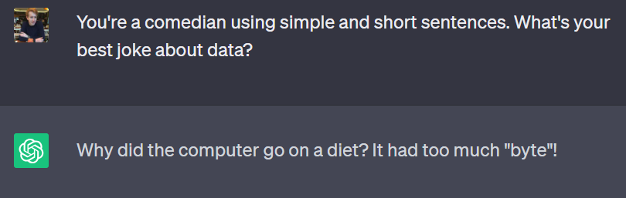

"an impressionist oil painting of a Canadian man riding a moose through a forest of maple trees"
Top (ChatGPT): https://chat.openai.com
Bottom (DALL-E 2): The best AI image generators in 2023 | Zapier

Slide 3
Artificial Intelligence
Field that encompasses the development and implementation of computer systems that can perform tasks requiring human intelligence.
Examples:
Self-driving care
Voice assistants (for example, Amazon Alexa)
Machine Learning
Enabling computers to learn and improve from data without explicit programming.
Examples:
Spam filtering
Predictive maintenance
Sentiment analysis
Deep Learning
Utilizes artificial neural networks with multiple layers to learn and represent complex patterns in data.
Inspired by the structure and function of the human brain.
Examples:
Computer Vision
Natural language processing
Recommender systems (e.g. Netflix)

Slide 4
Artificial Intelligence
Examples:
Self-driving care
Voice assistants (for example, Amazon Alexa)
Machine Learning
Deep Learning
Examples:
Spam filtering
Predictive maintenance
Sentiment analysis
Generative AI
Leveraging algorithms to enable computers to learn from data and generate new, original content or data instances based on learned patterns.
Examples:
ChatGPT
Midjourney
Stable diffusion
etc.
Examples:
Computer Vision
Natural language processing
Recommender systems (e.g. Netflix)

Slide 5









Our AI Plan on a Page
“AI Everywhere”
We drive the transformation of VodafoneZiggo into an AI driven company by infusing AI in every part of our business thereby creating tangible value for our customers and VodafoneZiggo
Mission
Marketing & Sales
Build smart, personalised marketing & sales engine to attract prospects, retain and grow (converged) customers
Operations
Drive towards predictive maintenance to improve network & product experience
Innovation
Invest in developing new AI driven products &
propositions
Where to play
& how to win
Enablers
Cloud
Big Data
Talent
Agile
Partners
Value
In 2023 we added ±11 million EUR of additional value (increase revenue/reduce costs/increase NPS) and have > 25 models running in production
CUSTOMER
CENTRIC
AI
DRIVEN
DIGITAL
FIRST
AGILE WAY
OF WORKING
Digital Future
AGILE WAY
OF WORKING

Slide 6





Enable smarter digital experiences through Generative AI
Successful application of generative AI involves disciplines across the VZ organization, we have identified 6 focus areas:
100110101101110
Potential
Platform capabilities
People
Policies & risk management
Partners
Process & data
Inspire and drive new demand, select and explore new ideas
Set up technical conditions to be able to adapt (and deliver) to changing GenAI landscape
Ensure impact on workforce is clear and plan for transformation through literacy and training
Guidelines on how to use GenAI in a responsible way, protect customers and workforce privacy
Build new partnerships and strengthen existing ones
Data quality is a key enabler for generative AI, ensure ownership and governance on data

Slide 7
Focusing on LLMs, it enables a range of capabilities
Classification
Translation and Transformation
Category classification (based on examples) or basic prompt for detecting sentiment (positive, negative element).
Direct translation of text from one language to any other.
Summarisation
Search
Summary of text into main messages or keywords.
Finding key information from a range of text.
Generation
Extract
Brief text or longform prose generation based on provided prompt (with or without example text).
Key theme and entity extraction from text or documents.

Slide 8
HR Chatbot

Slide 9

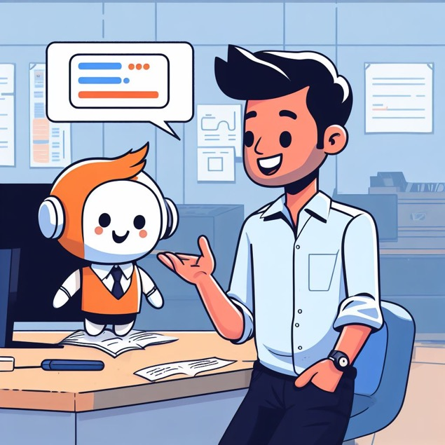



HR Chat – better knowledge retrieval for colleagues and HelloHR
Within VodafoneZiggo, employees can find information on policy, practices and systems through self-service or answers from a specialist.
Finding information through these channels consumes time for both employee and HR
To reduce time spent by HR and employees on finding answers to HR-related questions and improve employee experience, the ability to self-service in case of HR questions can be improved.
In order to improve the ability to self-service, a chatbot solution is developed capable to answer questions about the employee journey correctly
An employee is helped by a cute chatbot in finding an answer to their question, in the style of calvin and hobbes

Slide 10
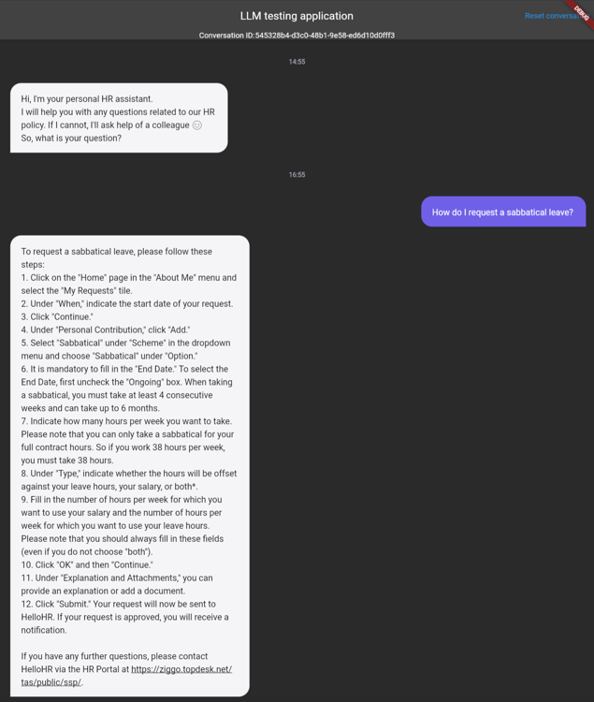


HR Chat – How does it work?
1
Employee
asks a question
2
An AI model retrieves
relevant documents about HR policy
ChatGPT generates an answer based on the question, how to behave and relevant documents
3
The testing interface of the D&AI Chatbot Squad

Slide 11

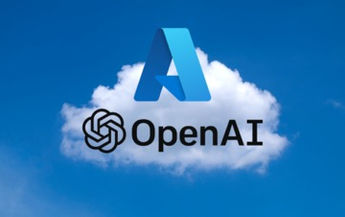
HR Chat – Under the hood: how do we get an answer?
A question
(Five) relevant documents
A prompt format
Je bent de HR-chatbot van VodafoneZiggo. Je helpt medewerkers met het beantwoorden van vragen over contract, salaris, vakantie en andere diverse HR-gerelateerde zaken. Je volgt de volgende richtlijnen:
- Je spreekt Nederlands.
- Je beantwoordt vragen zoveel mogelijk met behulp van de documenten in de context, in eenvoudige bewoordingen.
- De gebruiker ziet deze context niet, dus vat je de context samen als dit nodig is in het antwoord.
- Als het antwoord een instructie is voor de medewerker, geef je een stap-voor-stap plan.
- Als er wordt verwezen naar een IT-systeem dat niet duidelijk uit de context blijkt, wordt verwezen naar Oracle voor algemene vragen of vragen over GROW, Benefit Connect voor vergoedingen en budget, en Progress4u voor cursussen.
- Als je de vraag niet kan beantwoorden met de context, wordt de medewerker doorverwezen naar HelloHR, te bereiken met link https://ziggo.topdesk.net/tas/public/ssp/.
begin van context: {context}
einde van context
Vraag van de medewerker: {query}

Slide 12
Service Scan

Slide 13
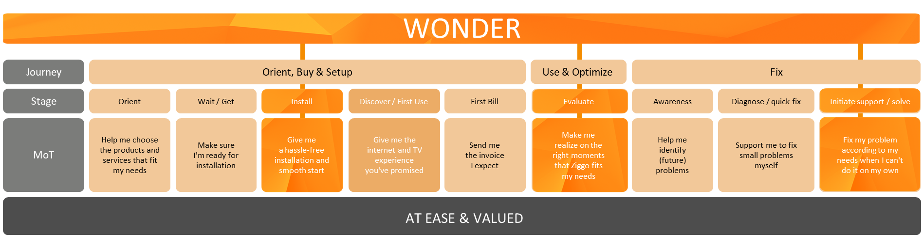


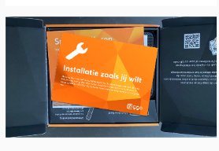

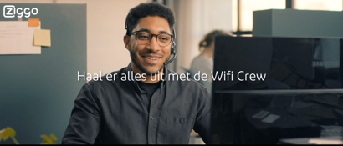


Creating a new service proposition as part of our Exceptional CX ambition
Installation the way you want it
Although we let our customers start with self-install, we provide them with the option of direct, fast and high-quality support with our Installation Crew.
Ziggo ServiceScan
We proactively contact our customers based on smart signal data to check if they are experiencing issues & ensure they have a perfect set-up through the ‘Ziggo Extra Service Inclusief’ Technician
WiFi Crew
A team of experts that is always ready to help you solve your issues and does not stop until it is solved with the help of Virtual Customer Support system.
Scope for today

Slide 14
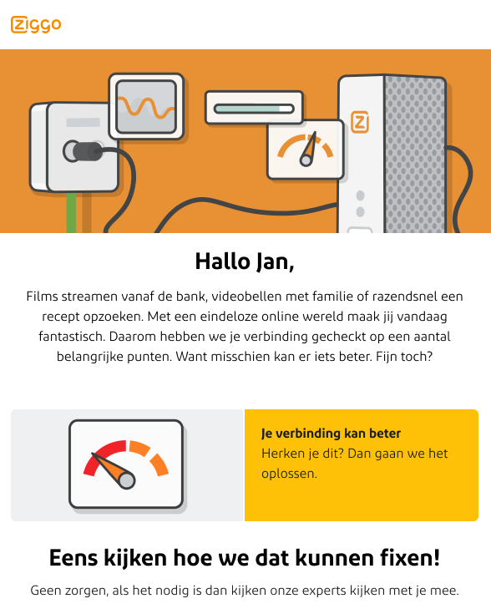
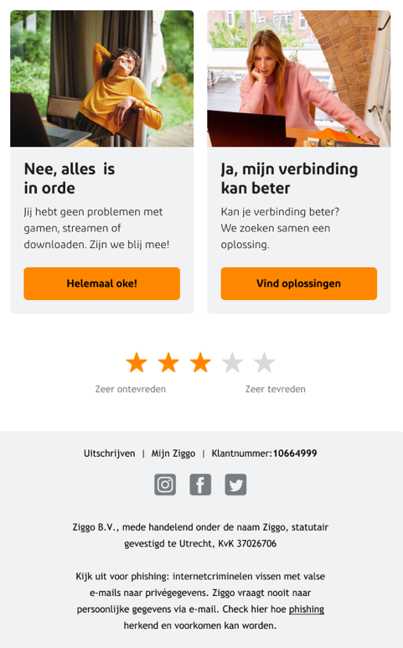
When a customer has got issues according to the data we will reach out to help them

Slide 15

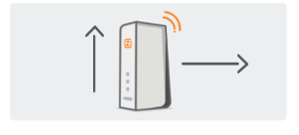
The basis of the Service scan is the Health check model which identifies root-causes of customer issues
3. What is the rootcause
of the problem?
1. Is there a signal problem on the modem?
2. Where is the issue located?
Health Check
Group
Check
In-Home Check
Drop
Cable
Issues
Detection
Rootcause
Locator
+
Rootcause
Detector

Slide 16
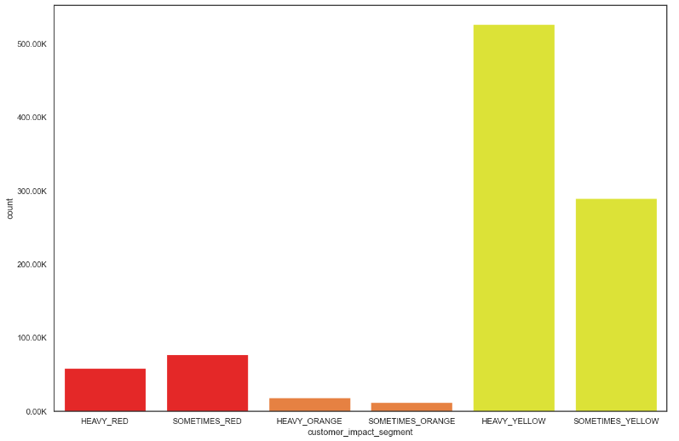

Service Scan Flow & insights
Combination of models to determine customer impact y/n
Health check divided in Customer impact segments
Is the customer having problems with the internet signal?
no
Green group
yes
Are the problems happening periodically over the last 10 days?
no
Green group
yes
Are the problems strong enough to cause customer impact?
no
Green group
yes
Can the customer solve the problem himself?
no
yes
Call me now Wifi Crew
Self Service
Pages
Call me now Wifi Crew

Slide 17
Are you a Disney+ look-a-like?

Slide 18
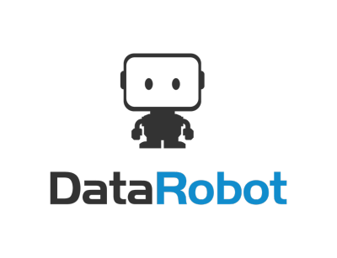
DataRobot is an automated machine learning capability that will help us enable the business user and scale AI.
Extensive selection process involving and supported by:
  The Analyst Community of Practice
  IT
  Legal
  Procurement
Enables analysts to create predictive models and insights without the need for any code.
We are scaling as we speak:
  Identifying use cases
  Training analysts
  AI Specialist guidance and assistance
  Setting up data connectivity and governance

Slide 19
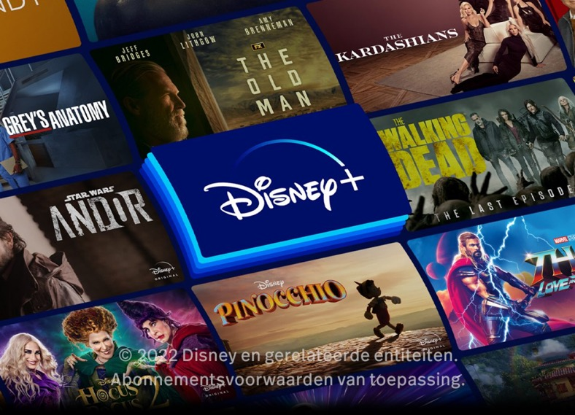
As part of our Endless Entertainment program we want to drive customer loyalty through (on-screen) entertainment aggregation
By driving customers to use the Disney+ app on our mediabox, we can learn more about our customers’ entertainment interest and give better and more personal recommendations.
The base for our predictive model:
10.000 customers: 50%-50% split (no) Disney+.
6 months of viewing behavior (before Disney+ introduction)
    Other OTT-apps
    Linear TV
    Radio
    Genres
    Socio demographics
    Customer details
Can we predict whether someone will be watching Disney+ on our mediabox?

Slide 20
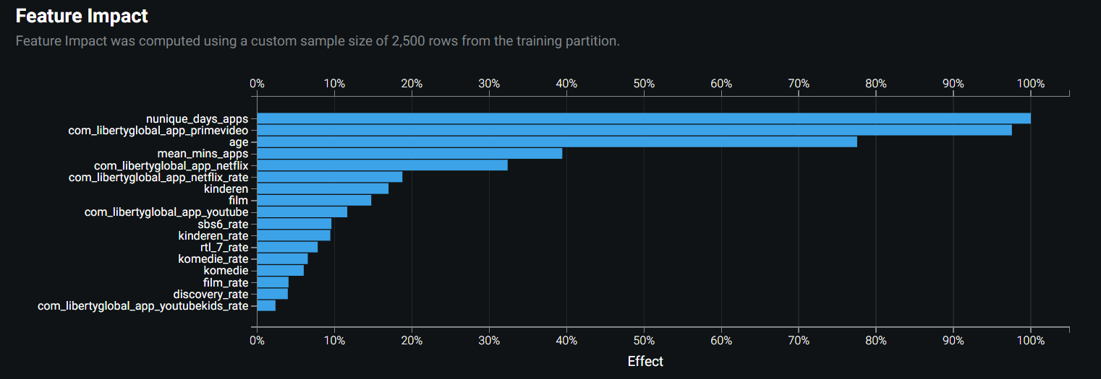
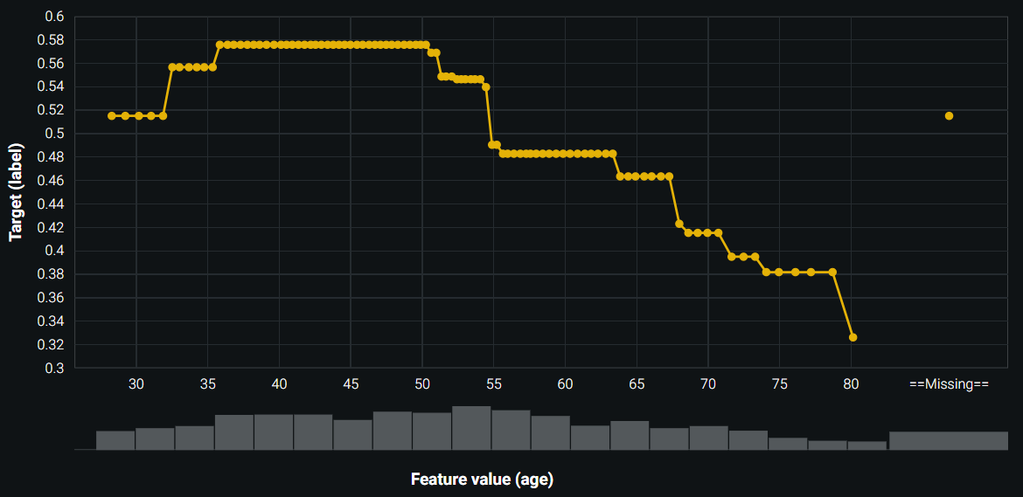
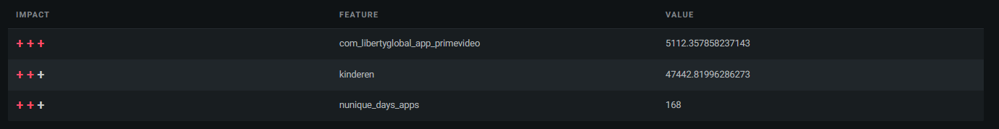
We were able to kickstart this project by using DataRobot as a tool for our initial model(s) and get to the core of what is relevant.

Slide 21
The usage of other OTT-apps proves to have a good predictive value when it comes to identifying (potential) Disney+ users.

Slide 22
There is a clear relation between customer age and the likelihood of Disney+ usage, peaking for those between 30-55 years.

Slide 23
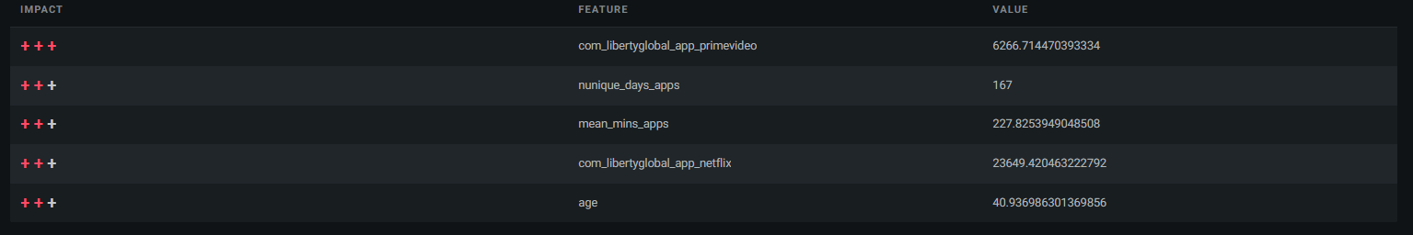
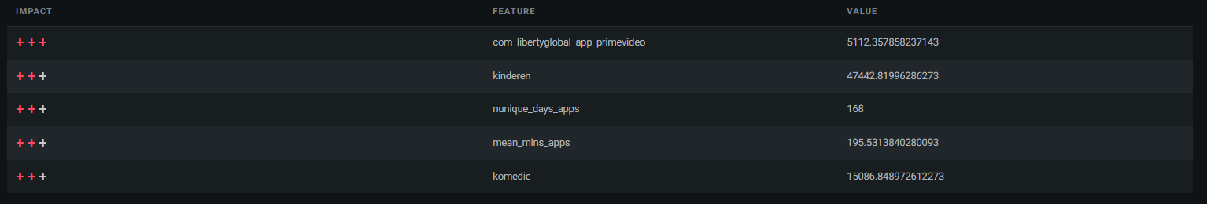
We can experiment with different communications, to make sure they are in line with customers’ personal interest.
Customer A
Customer B

Slide 24
Let’s talk

Slide 25

AI is de sleutel tot ongeëvenaarde efficiëntie in elk bedrijfsproces.

Slide 26

Voor 20% van mijn medewerkers gaat de Data en AI transitie te snel

Slide 27

Datakwaliteit is bij ons een groot probleem en dit staat ontwikkeling met AI in de weg

Slide 28

Bedrijven die AI niet omarmen, zullen binnen een decennium irrelevant worden

