Slide 1
VodafoneZiggo- Let me hear you say YEAH

Slide 2
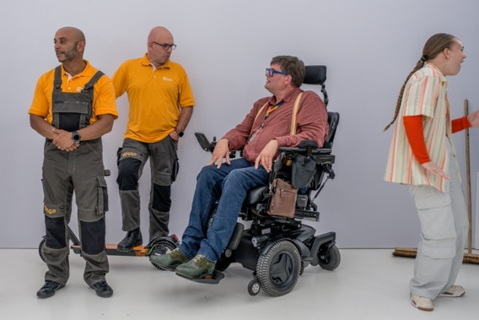
Notes:
Brug naar employer brand video – dit hebben we gedaan met eigen mensen. Wij zijn en maken nog steeds VodafoneZiggo
Ik word duizelig van deze VR headsets
Net zo duizelig van de impact die AI op ons gaat hebben
Ik sta hier niet als de expert. Die komt nog aan het woord.
Wil het hebben over de manier waarop we dit als leiders kunnen omarmen. Ook al begrijpen we er niets van.
Want waar de metaverse nog steeds een belofte is, beinvloedt AI onze levens al elke dag

Slide 3
Tackle 5 strategic questions to unlock the opportunities of Generative AI
Potential
Platform capabilities
Policies & risk management
People
Partners
Which use-cases drive strategic advantage and how do we best unlock their value?
Which capabilities do we need to deliver Generative AI use-cases (buy, develop & adapt)?
How do we install the right guardrails to mitigate risks of GenAI (privacy, ethics) while allowing for fast experimentation?
How do we prepare our workforce for Generative AI?
What partnerships do we need to initiate and what partnerships do we need to revise?

Slide 4
You as a leader today
1. Understand what you are doing already
3. Start with a guild or project team to experiment with first use cases
2. Embed AI in the strategy of your company
4. Think about the impact on your:
Organization
Leadership
Notes:
Understand what you are doing already
Embed AI in the strategy of your company
Start with a guild or project team to experiment with first use cases
Think about impact on organization
Think about impact on leadership

Slide 5
1. Understand what you are doing already
Artificial Intelligence (AI)
Machine Learning (ML)
Natural Language processing
(NLP)
Deep Learning (DL)
Large Language Models (LLMS)

Slide 6
2. Embed AI in the strategy of your company
AI EVERYWHERE To radically change our business and increase impact
EXCEPTIONAL EXPERIENCE built on data & AI
DATA & AI AS A PRODUCT we take E2E ownership of full product lifecycle
EXCEPTIONAL DATA ALWAYS AVAILABLE we secure availability and govern quality of data
WORKFORCE OF THE FUTURE Modern engineering skills driving data innovation
DATA VALUE LEADERSHIP We act as data business partner to codevelop the most valuable data & AI use cases

Slide 7
3. Start with a guild or project team to experiment with first use cases
Generative AI Guild
Guilds Objectives
To inspire and stimulate adoption of generative AI within VZ
To collect and share knowledge
To create awareness on our security and privacy guidelines in relationship to ChatGPT
To coordinate and create focus in experiments and pilots
Michiel van Rijthoven
Reint van der Torn
Pepijn van Veen
Vincent Klein Breteler
Example of current pilots
Developer’s Co-Pilot within IT4IT, Digital and D&AI
Chatbot enhancement (TOBi, Deepdesk)
Entertainment recommendation engine for customers for entertainment
Preparing for Microsoft O365 Co-Pilot
GPT integration in Azure platform

Slide 8
4a. Think about the impact on your organization
Creative
Expert work
Centralize
Interpersonal expert work
Augment
Interpersonal
Interpersonal work
Deskill
Routine work
Automate
Notes:
Sampson, S. E. (2021). A Strategic Framework for Task Automation in Professional Services. Journal of Service Research, 24(1), 122-140.]
Horizontaal: Interpersonal skill requirement
Verticaal: Creative skill requirement

Slide 9
4b. Think about the impact on your leadership
Internal best practice focus
Functional mind-set
Incremental planning
Judgement driven decision making
Pace-setting & authoritative
Be bold,
experiment fail fast/scale fast
Empower,
coach & hold to account
External
radar
Customer & product
obsessed
Data & AI driven
decision making

Slide 10
The future is exciting. Ready?

